Slide 1
DEVELOPMENT OF A TRAVEL RELATED SOFTWARE APP THAT CAN BE INSTALLED ON MOBILE PHONES THAT COULD CAPTURE TRIP RELATED INFORMATION
CSE 7032- University Project
Review-5
Batch Number: CSE_178
Roll Number | Student Name
20221CSE0652 | ANEESA MA
20221CSE0658 | BHAVANA C
20221CSE0660 | BODHINI DB
Under the Supervision of,
Ms. Anu Joseph, Ms Fathima Shana
Assistant Professor
School of Computer Science and Engineering
Presidency University
Name of the Program: CSE 7032 - UNIVERSITY PROJECT
Name of the HoD: Dr. Blessed Prince
Name of the Program Project Coordinator: Dr. Muthuraju V
Name of the School Project Coordinators: Dr. Sampath A K

Slide 2
Content
Abstract
Objectives of problem statement
Background and Related work
Proposed Method & Feasibility Study
Architecture Diagram
Innovation or Novel Contributions
Tech Stack
Github Link
References

Slide 3
Abstract
Problem Statement Number : 25082
Organization: KSCSTE-NATIONAL TRANSPORTATION PLANNING AND RESEARCH CENTRE (NATPAC)
Category : Software
Traditional travel surveys fail to capture complete trip chains, dynamic travel patterns, and multi-modal journeys effectively.
The objective of this project is to develop a travel-related mobile application that can be installed on smartphones to capture trip-related information automatically and semi-automatically.
With explicit user consent, the application will:
Detect trips using GPS and time-based sensing
Automatically capture origin, destination, and travel duration
Prompt (nudge) users to fill in contextual details such as trip purpose and mode of transport
The application will automatically track user journeys using Google location services and allow users to enrich their trips with checkpoints, photos, and personal notes—creating a diary-like travel experience. All collected data will be securely stored and managed using Supabase, making it accessible for both users and authorized NATPAC researchers.

Slide 4
Objectives of Problem Statement
Automatically detect trips using GPS and temporal data.
Capture origin, destination, travel duration, and route details.
Prompt users to provide contextual trip details, including purpose and mode of transport.
Allow users to enrich trips with photos, checkpoints, and personal notes.
Store data securely using Supabase, ensuring both user privacy and accessibility for authorized researchers.
Provide a diary-like travel experience for users while enabling research on travel behavior patterns.

Slide 5
Background and Related Works
Background
Traditional travel surveys → Capture trips manually but often incomplete and inaccurate.
Paper-based transport studies → Cannot record multimedia or real-time location.
Smartphone GPS tracking → Enables automatic and semi-automatic trip data collection.
Related Works
Google Trips & TripIt → Good for itineraries, lack research context.
Digital diary apps (MyTriplan, MoBiT) → Manual logging, limited automation.
[1] Vansteenwegen et al. (2011) and [3] Gavalas et al. (2014) discuss route optimization and tourist trip design problems, focusing on algorithms and heuristics for planning efficient, time-constrained travel itineraries.
[2] Ricci et al. (2015) explains recommender system techniques such as collaborative and content-based filtering, which support personalized travel recommendations based on user data.

Slide 6
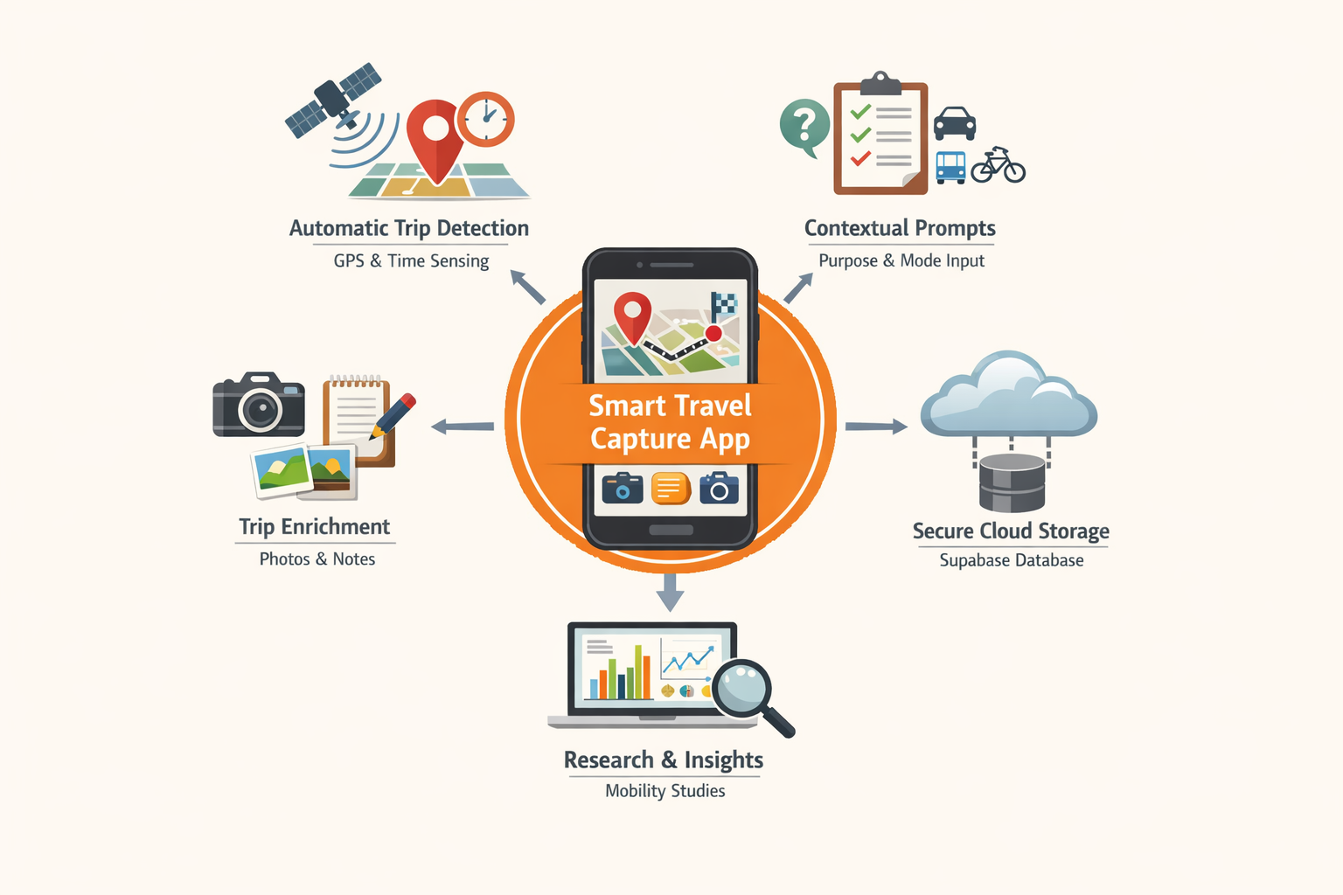
Proposed Method & Feasibility Study
Develop a mobile travel app integrating Google Maps and Google Location APIs to automatically track trips (origin, destination, route, distance, time).
Enable users to enrich journeys with checkpoints, photos, and notes, creating a diary-style travel log.
Use Supabase for secure authentication, real-time database management, and cloud storage.
Implement an AI module to analyze historical travel data, generate personalized insights, and provide future trip recommendations.

Slide 7
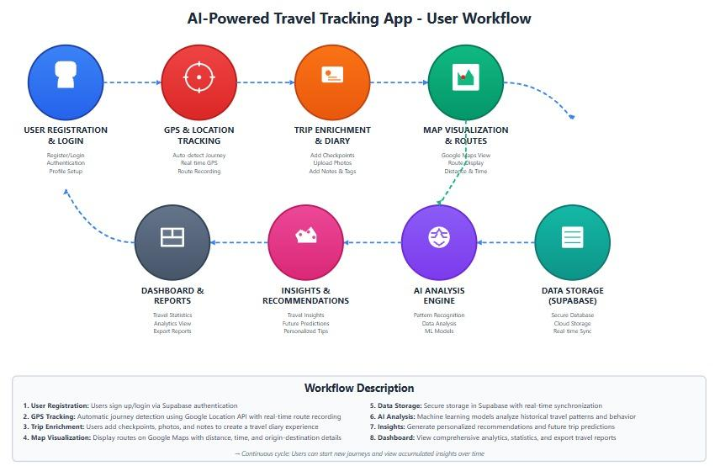
Architecture Diagram

Slide 8
Innovation or Novel Contributions
Smart Trip Capture → Automatically logs trips using GPS and time sensing.
Multimedia Enrichment → Adds photos, notes, and checkpoints for each journey.
Interactive Map Visualization → Highlights routes and visited regions dynamically,and total distance traveled.
Cloud-Enabled Research Access → Securely shares anonymized travel data with researchers.
Social Feedback & Insights → Enables comments, ratings, and peer reviews on trip checkpoints.
AI trip recommendation → helps with generating the next possible trip plans using transformer models based on user history

Slide 9
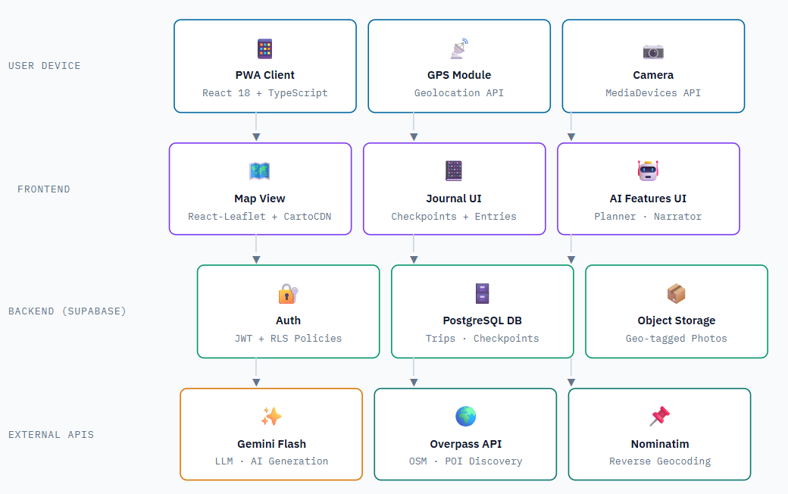
Tech stack

Slide 10
Github Link
This Github link has public access permission.
https://github.com/aneesaMA/CSE_178.git

Slide 11
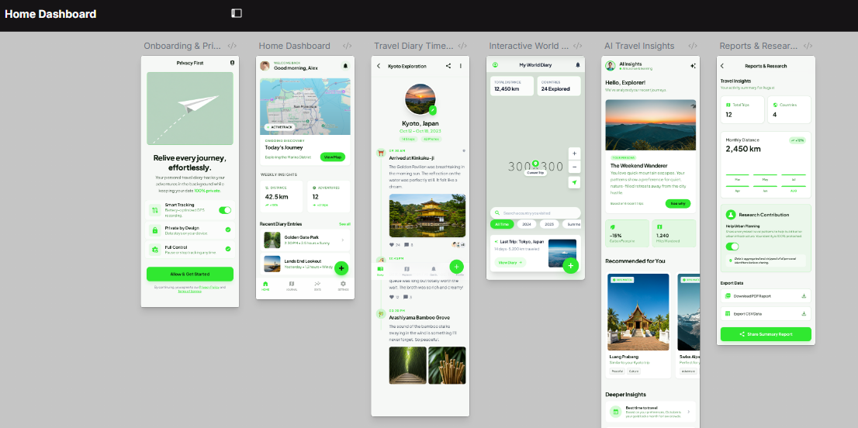
Wireframes

Slide 12
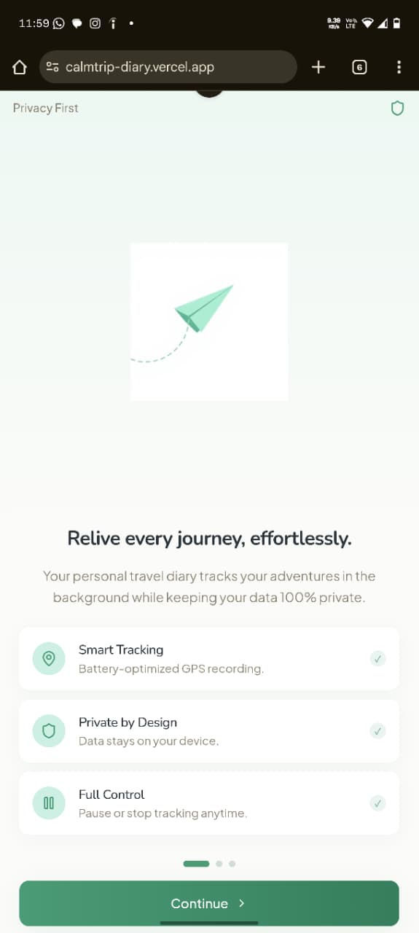
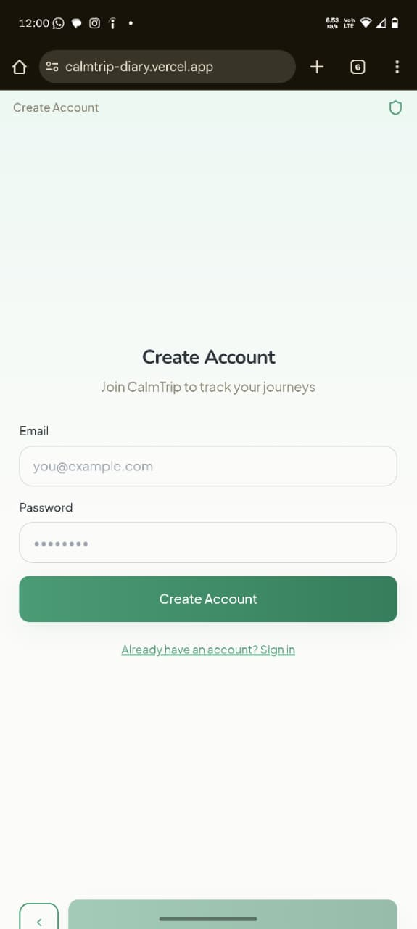
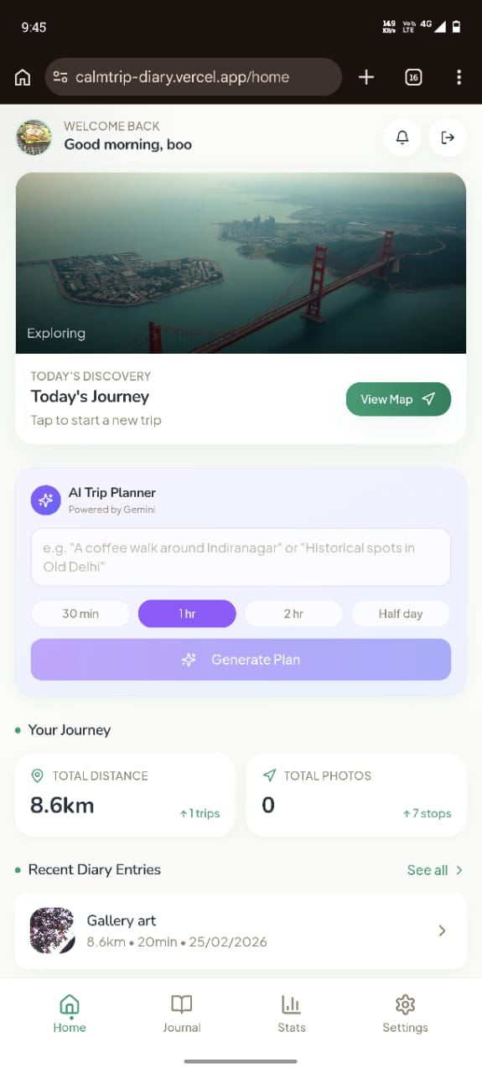
Screenshots of Calm Trip:

Slide 13
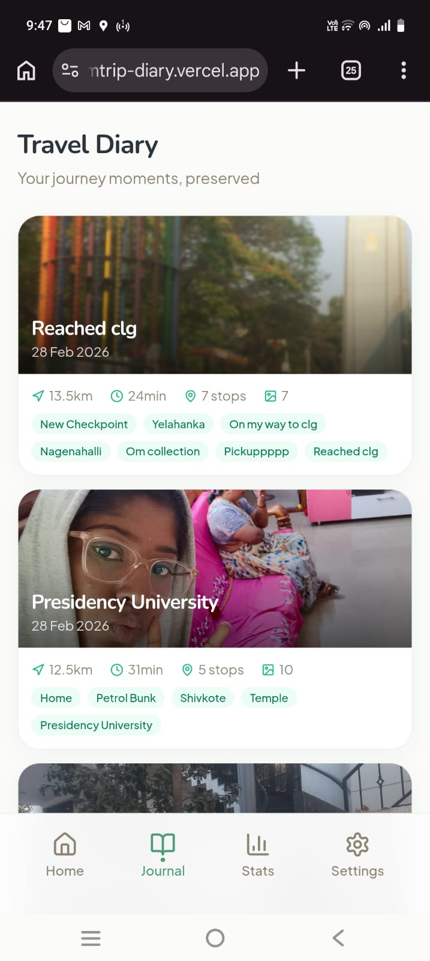
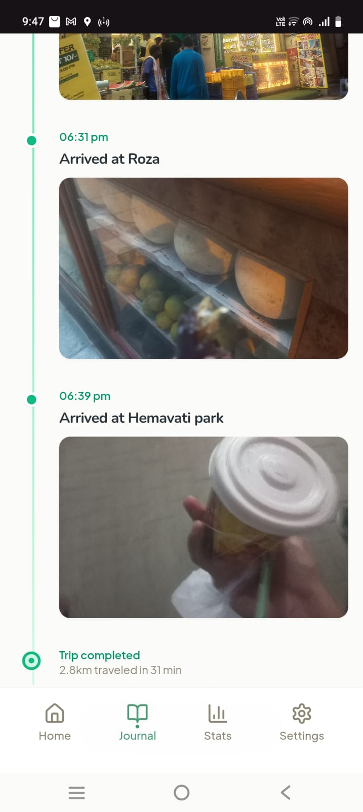
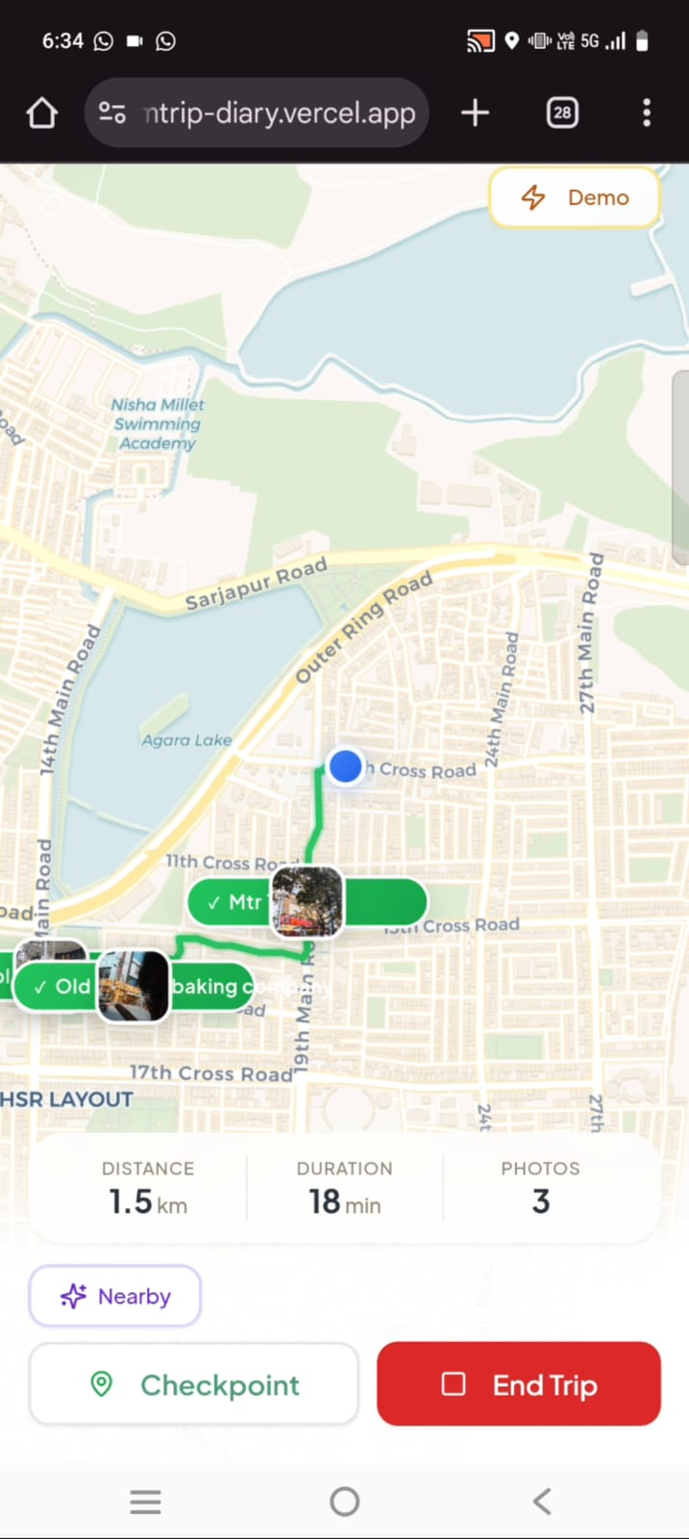
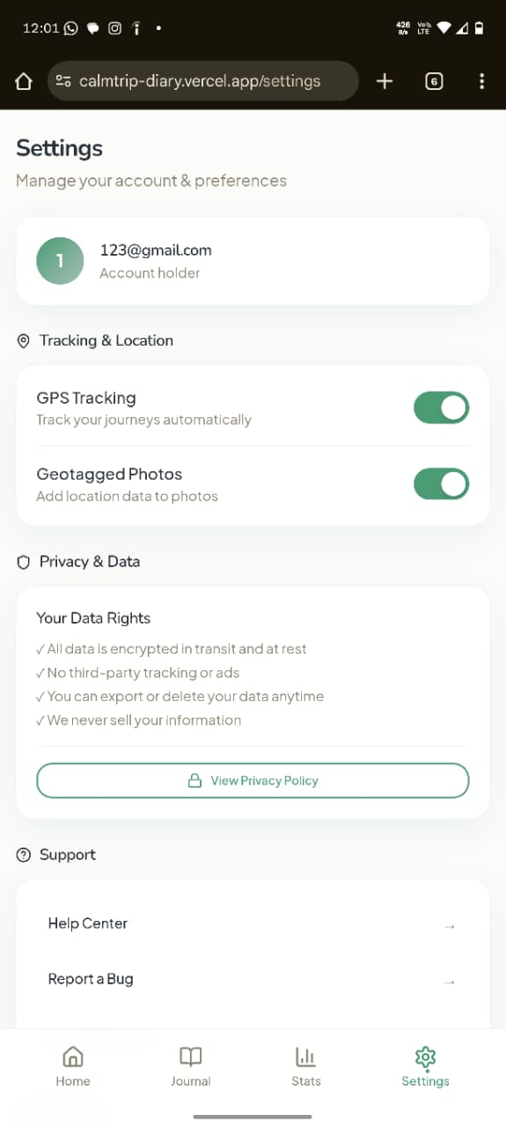
Screenshots of Calm Trip:

Slide 14
References
[1] P. Vansteenwegen, W. Souffriau, and D. Van Oudheusden, “The orienteering problem: A survey,” European Journal of Operational Research, vol. 209, no. 1, pp. 1–10, 2011.
[2] F. Ricci, L. Rokach, and B. Shapira, Recommender Systems Handbook. Cham, Switzerland: Springer, 2015.
[3] D. Gavalas, C. Konstantopoulos, K. Mastakas, and G. Pantziou, “A survey on algorithmic approaches for solving tourist trip design problems,” Journal of Heuristics, vol. 20, no. 3, pp. 291–328, 2014.
[4] O. D. Lara and M. A. Labrador, “A survey on human activity recognition using wearable sensors,” IEEE Communications Surveys & Tutorials, vol. 15, no. 3, pp. 1192–1209, 2013.
[5] Y. Zheng, “Trajectory data mining: An overview,” ACM Transactions on Intelligent Systems and Technology, vol. 6, no. 3, pp. 1–41, 2015.

Slide 15


